Slide 1
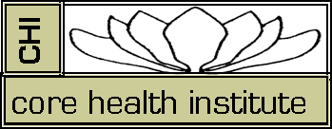
CHINESE MEDICINE IN YOUR LIFE

Slide 2
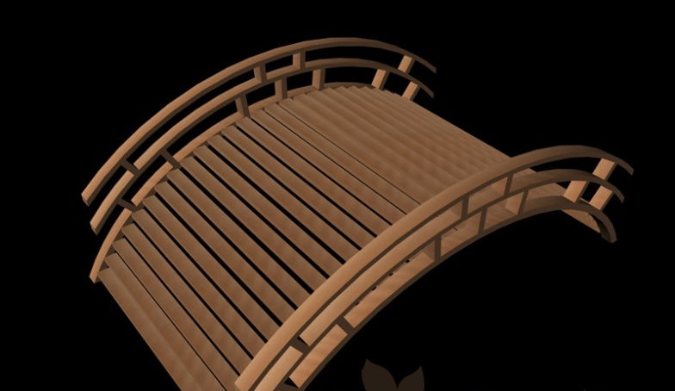
WEST MEETS EAST
BODY AS MACHINE
BODY AS GARDEN

Slide 3
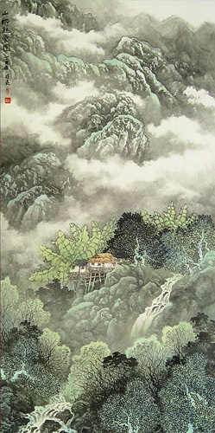
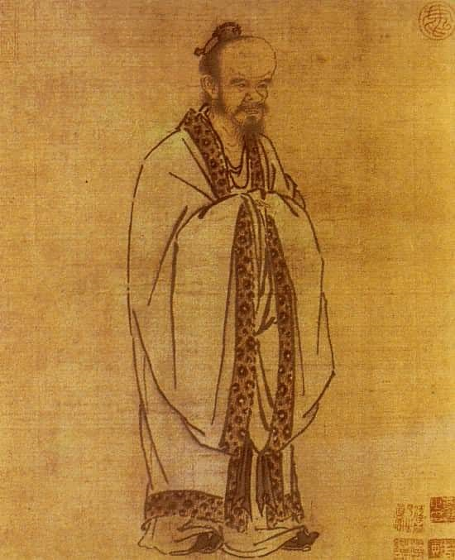
by Liao Lin Shen

Slide 4
CHI
Compassionate Self Awareness
. …the Art of Wellbeing
DO WHAT YOU KNOW
LIVE WHAT YOU SPEAK
BE WHO YOU ARE

Slide 5
CHI Self Care is simple effective program
that provides:
Immediate relief from stress and anxiety
Support & Coaching
Training in skills that can be used daily to increase:
Compassionate Self –Awareness
Emotional, Mental & Energetic Balance
Relaxation and Ease.

Slide 6
CHI Self Care Components
A seven point ear acupressure protocol using seeds or gold beads, taped to the ear for 3-7 days
Awareness of location and function of points
Daily Tranquil Moments, sitting quietly, grounded
Breathing Deeply- taking-time and space for the breath
Presencing: Compassionate Self Awareness or Watchfulness

Slide 7
YOU ARE THE BEING BEHIND THE DOING
You ARE pure consciousness
You HAVE a body, a mind, a biography,
AWARENESS
PRESENCE
Presence
can dissolve the Unconscious Past
in you
Awareness
is the driving force of change

Slide 8
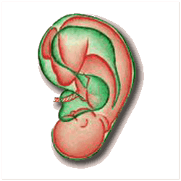
THE HOLOGRAM- THE FETUS IN THE EAR

Slide 9
The History: Auricular Acupuncture
Ear Points stimulated in Traditional Chinese Medicine
Dr Paul Nogier 1957,Lyons, France: the inverted fetus
Nanjing Army Ear Acupuncture Research Team: Mao TseTung-Barefoot doctors-1958
Dr. HL Wen: Hong Kong–Clinical studies for opiate detoxification (Wen & Cheung 1973; Wen 1977;Wen et al 1978,9)
-Dr. Michael Smith-Lincoln Hospital, N.Y.-Opiate drugs,cocaine, alcohol, & nicotine addiction withdrawal (Patterson 1974, Sacks 1975;Smith 1979)

Slide 10
The History Continued
University of California at Los Angeles (Oleson et al.1980) First double blind evaluation of auricular diagnosis.
Five Point Acupuncture protocol for substance abuse: NADA-- National Acupuncture Detox Association founded by Dr. Michael Smith 1990.
WHO standardized international point nomenclature 1990
Core Health Institute: CHI Self-Care Program to make Ear Acupressure protocol available to the general public without the use of needles.

Slide 11
THE CHI
AURICULAR ACUPRESSURE PROTOCOL

Slide 12
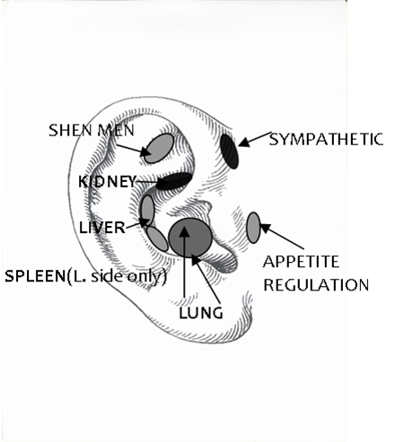
SHEN MEN-
SPIRIT GATE POINT:
Promotes centering, introspection and connection to Authentic Self and Core Consciousness. Stimulates joy, serenity, love and honor of true self.

Slide 13
2.SYMPATHETIC POINT:
Has a strong analgesic (pain relieving) effect. Increases calm, decreases stress and over reaction; resulting in a reduction of anxiety as well as, relaxation of internal organs and dilation of blood vessels

Slide 14
3.KIDNEY POINT Connects to the storehouse of energies that flow throughout the body. Calms fears, removes insecurities, and strengthens nervous, reproductive, endocrine and immune systems.

Slide 15
4. LIVER POINT
Promotes emotional balance and rules the smooth flow of CHI and BLOOD.
Promotes relaxation and confidence. Stabilizes mood swings
Decreases angry outbursts and increases self esteem and confidence

Slide 16
5. SPLEEN POINT
Supports the digestion of food as well as information and impressions. Aids integration and grounding of experience.
Especially important for children who have immature digestive systems and are exposed to information overload in the computer age

Slide 17
6. LUNG POINT
Alleviates toxicity in the immune, respiratory systems and skin.
Promotes expression of grief and ‘letting go’ of heavy feelings and former attachments, depression and sadness

Slide 18
7. APPETITE REGULATION
Supports weight management and appetite regulation through connection to the vagus nerve
Aids connection to to ‘authentic appetite’

Slide 19
EAR ACUPRESSURE
Helps children to relax and focus
Relieves Pain
Eases PTSD
Aids appetite regulation
Relieves addictive behavior
Helps relieve addiction detox
Relieves Stress
Aids Smoking Cessation

Slide 20
CHI CIRCLES: Community Acupressure
CHI Circles are a safe non-judgmental supportive environment in which participants can receive ear acupressure as well as learn stress management and life style skills which are supportive of their general wellbeing and specific relief from stress, distress, or pain or dysfunction in a cost-effective neutral setting
CHI Circles are conducted in libraries, schools community colleges, churches and living rooms in Michigan, Chicago, Sweden, England , Germany and South Africa, wherever people gather. …

Slide 21
TRAINING AND RESOURCES
www.acudetox.com -NADA Acupuncture training & research
www.CoreHealthInstitute.com –
CHI Self-Care &Ear Acupressure Training, free downloads, supplies, coaching & support
CHI Ear Bead Technician Training
CHI Circle Facilitator Training
“Chinese Medicine in our Life” classes & retreats

